Slide 1
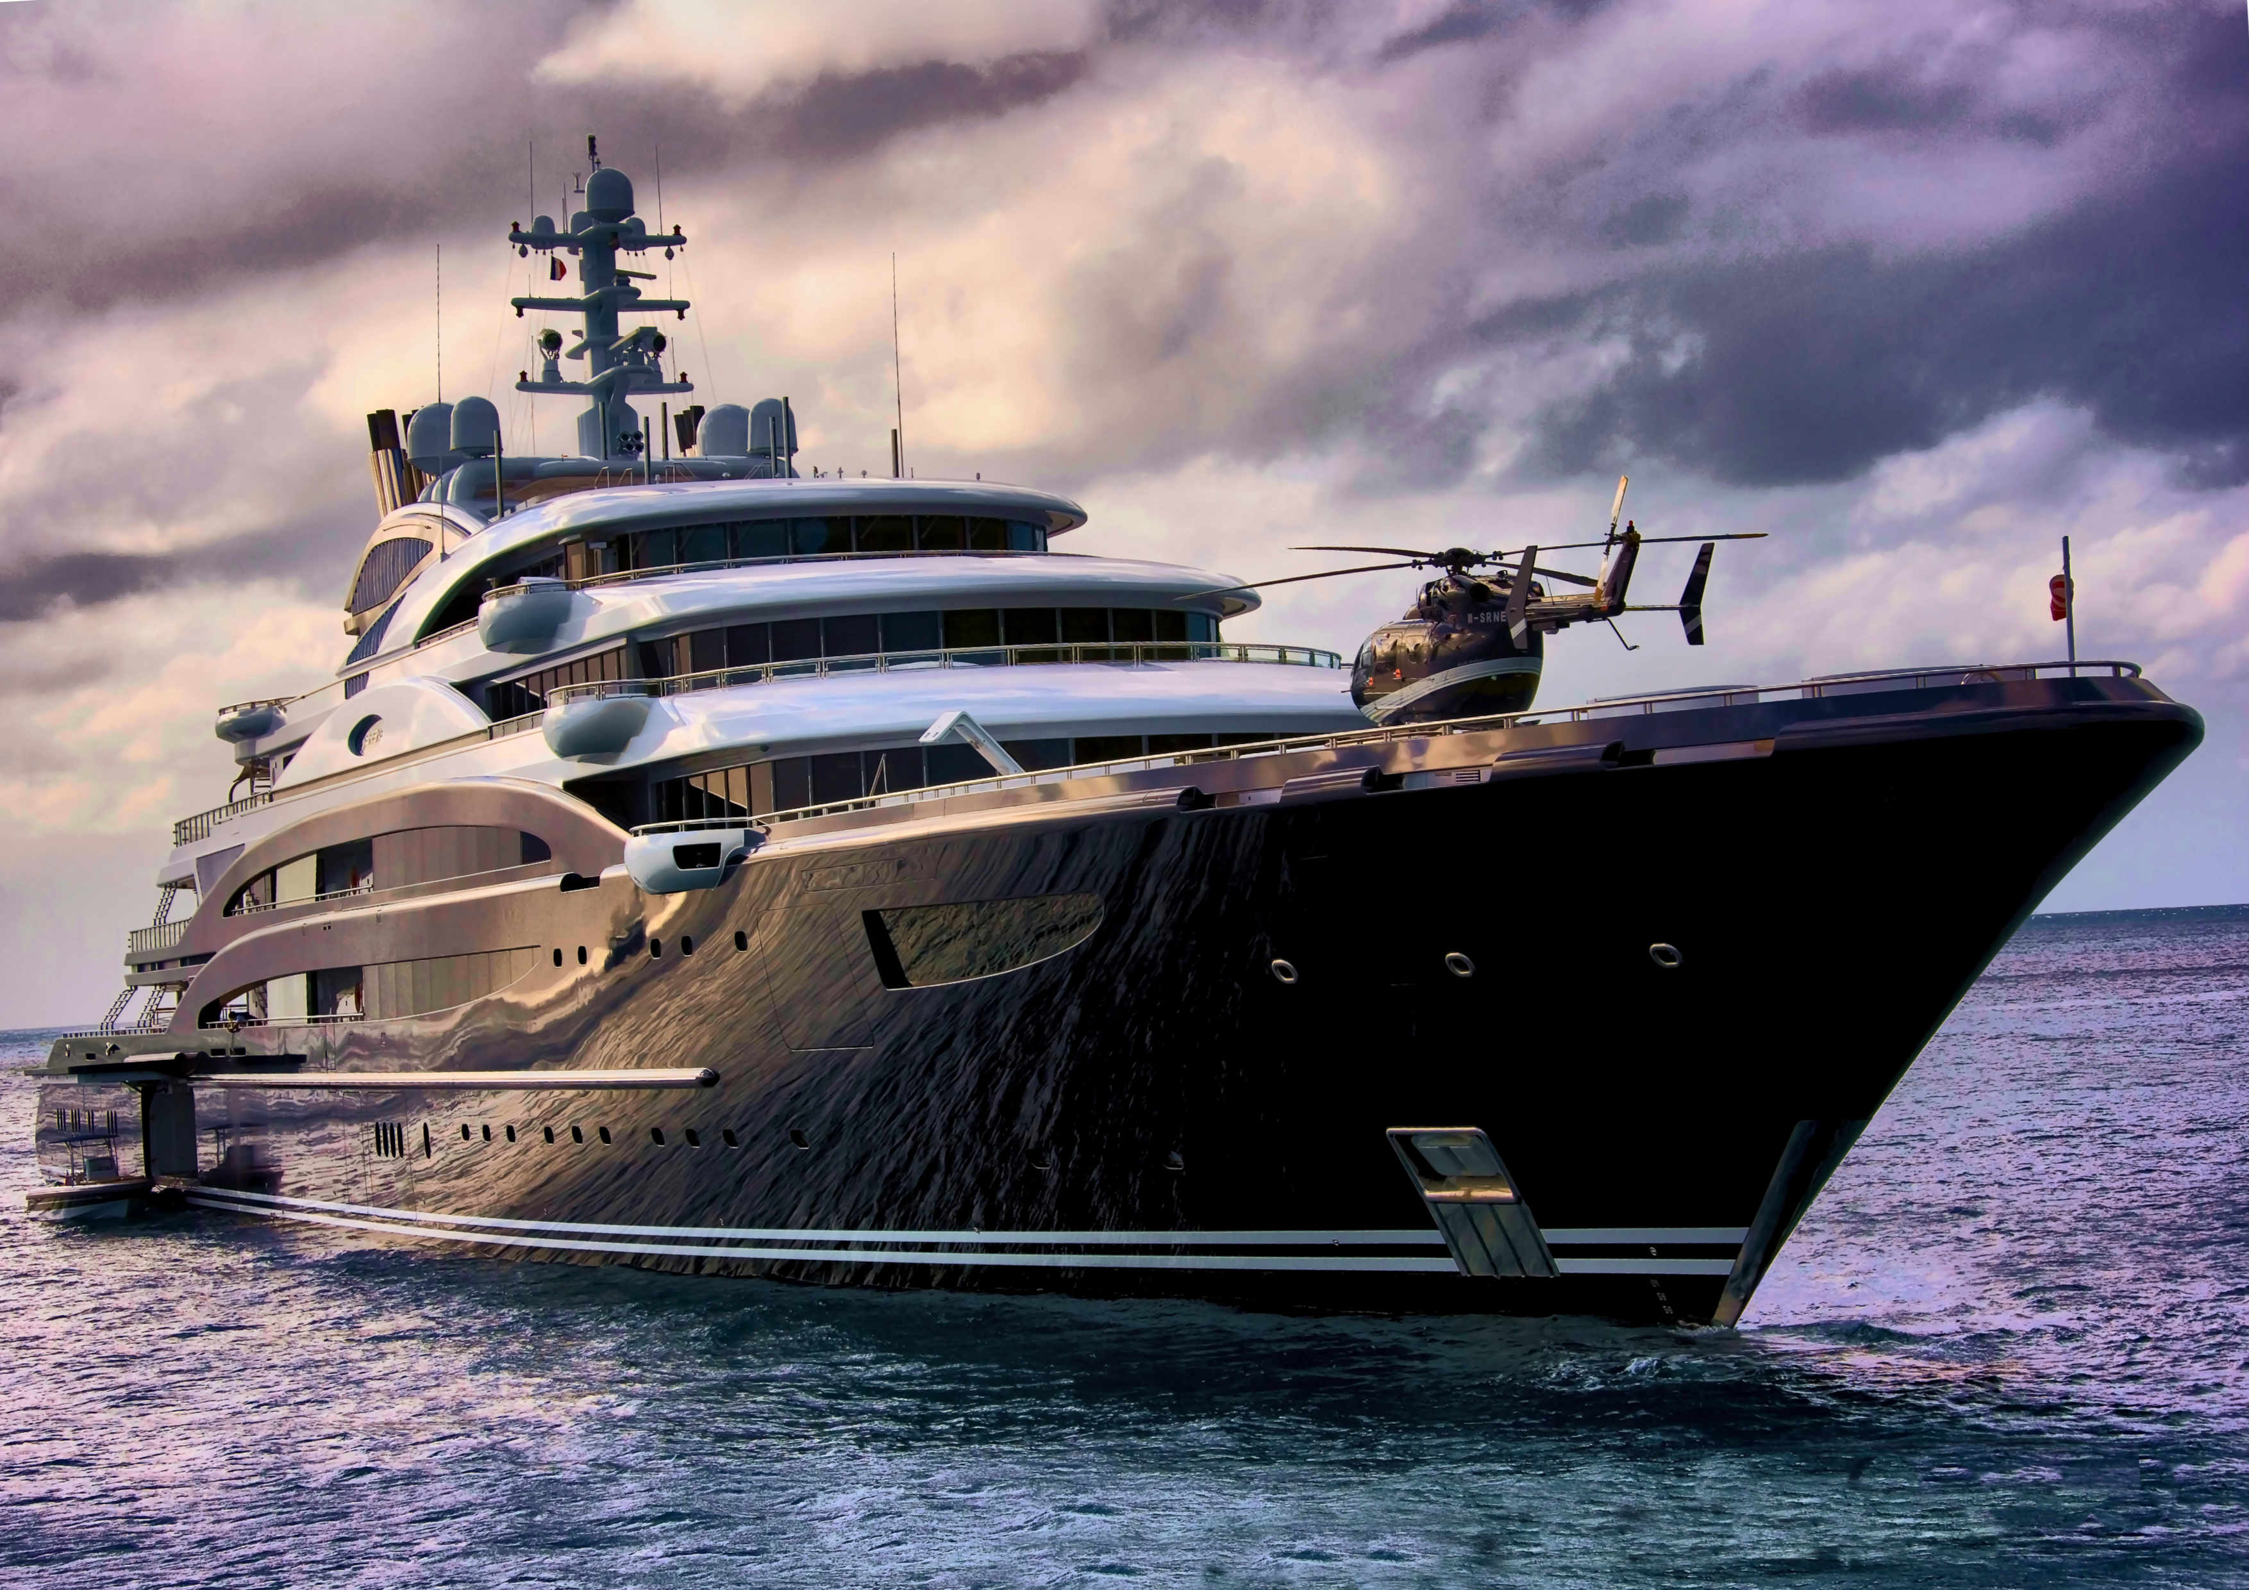
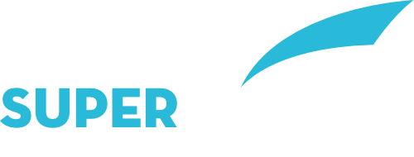

Slide 2
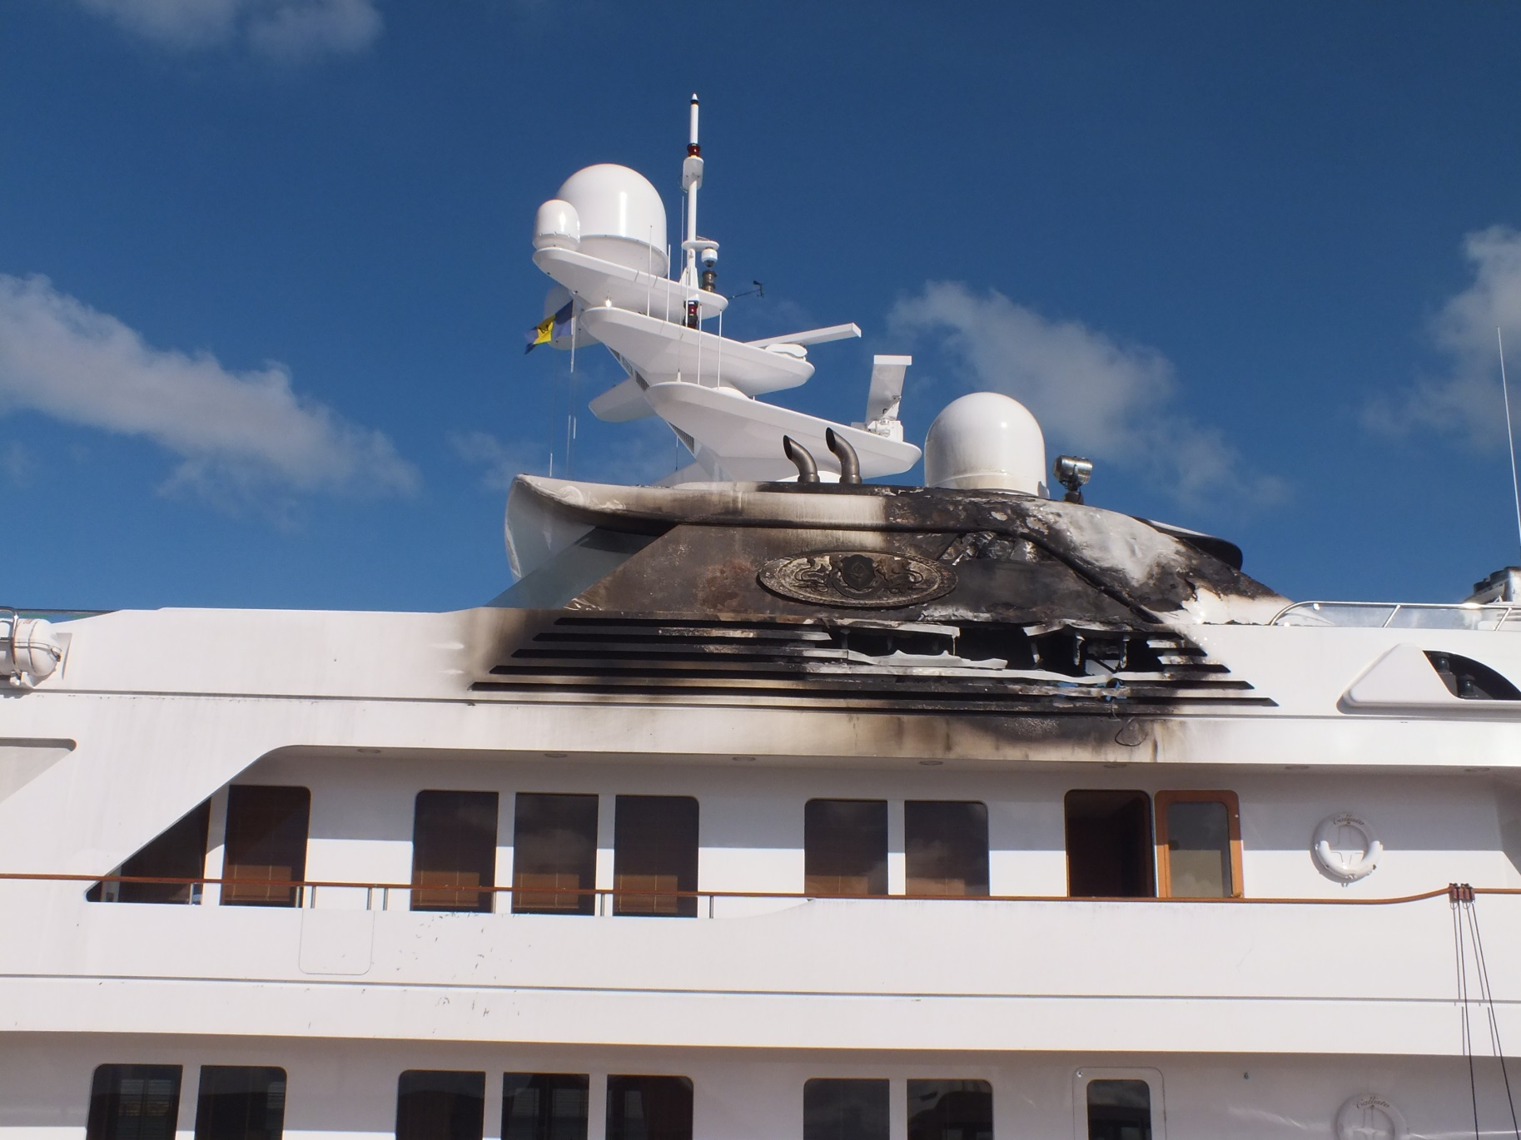
Safer crew
Safer yacht
Safer Guests
The Superyacht Training Group was established to bring together the World’s leading providers of onboard training to yacht crews, providing a simple, single point of contact solution to the maritime industry.
Drawing on the experience, professionalism and knowledge of this broad range of training providers, vessels emerging from build, refit or simply on operations can benefit from a full catalogue of services designed to ensure the crew remain at the forefront of their skill base for the benefit of all on board.
Our mission is to simplify the training of crew by providing a single point of administration contact who will work directly with the Heads Of Department on board to generate the training programme, liaise with the providers, amalgamate everything into a single invoice and continuously liaise with all relevant parties

Slide 3
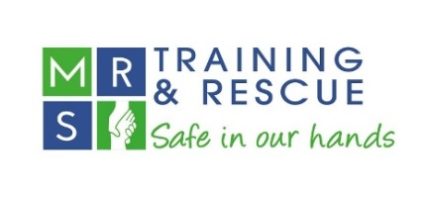



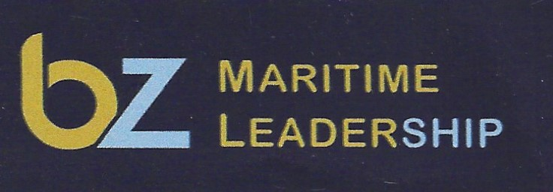
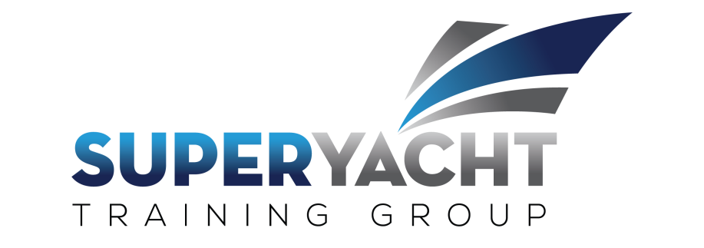



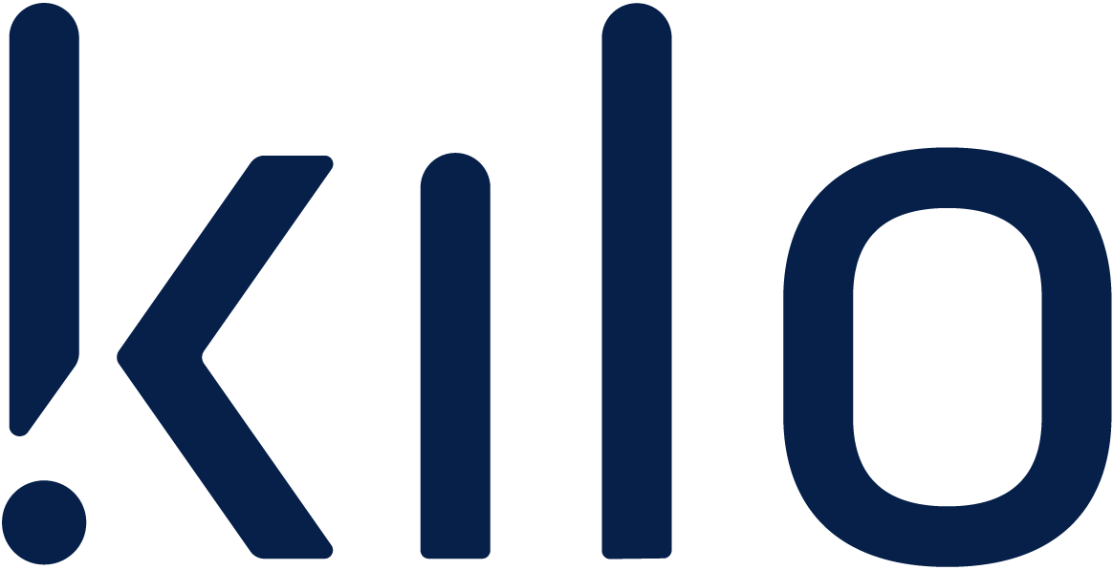
Our Members
All our companies are world leaders in their respective fields providing bespoke onboard training and consultancy. Whether it’s legislative training, training for a particular requirement or consultancy, our members have the all the expertise you require irrespective of the size of yacht.
Watch the summary video at this link.
ROMEO FOXROT

Slide 4
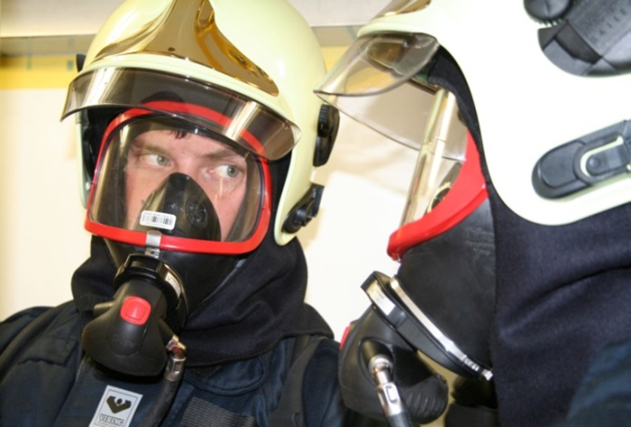
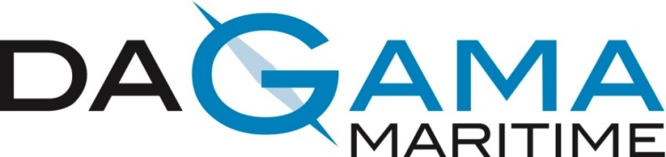
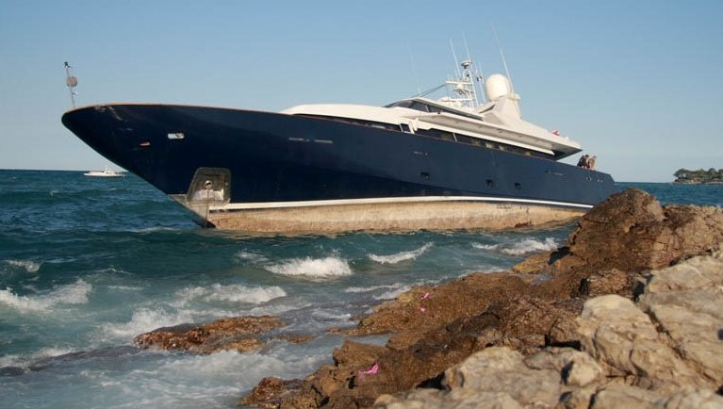
Providing an unsurpassed level of crew training in navigation and firefighting.
Da Gama maritime are predominately ex-mariners and professional experienced trainers who’s focus is on the maintenance of safety at sea and engagement with crew for the development of procedures and skills.
On-board training available -
Firefighting
Li-ion battery use and firefighting
Crowd control
Crisis Management (MCA Accredited)
Outfit management
Navigation procedures
Navigation assessments
ECDIS risk assessments

Slide 5
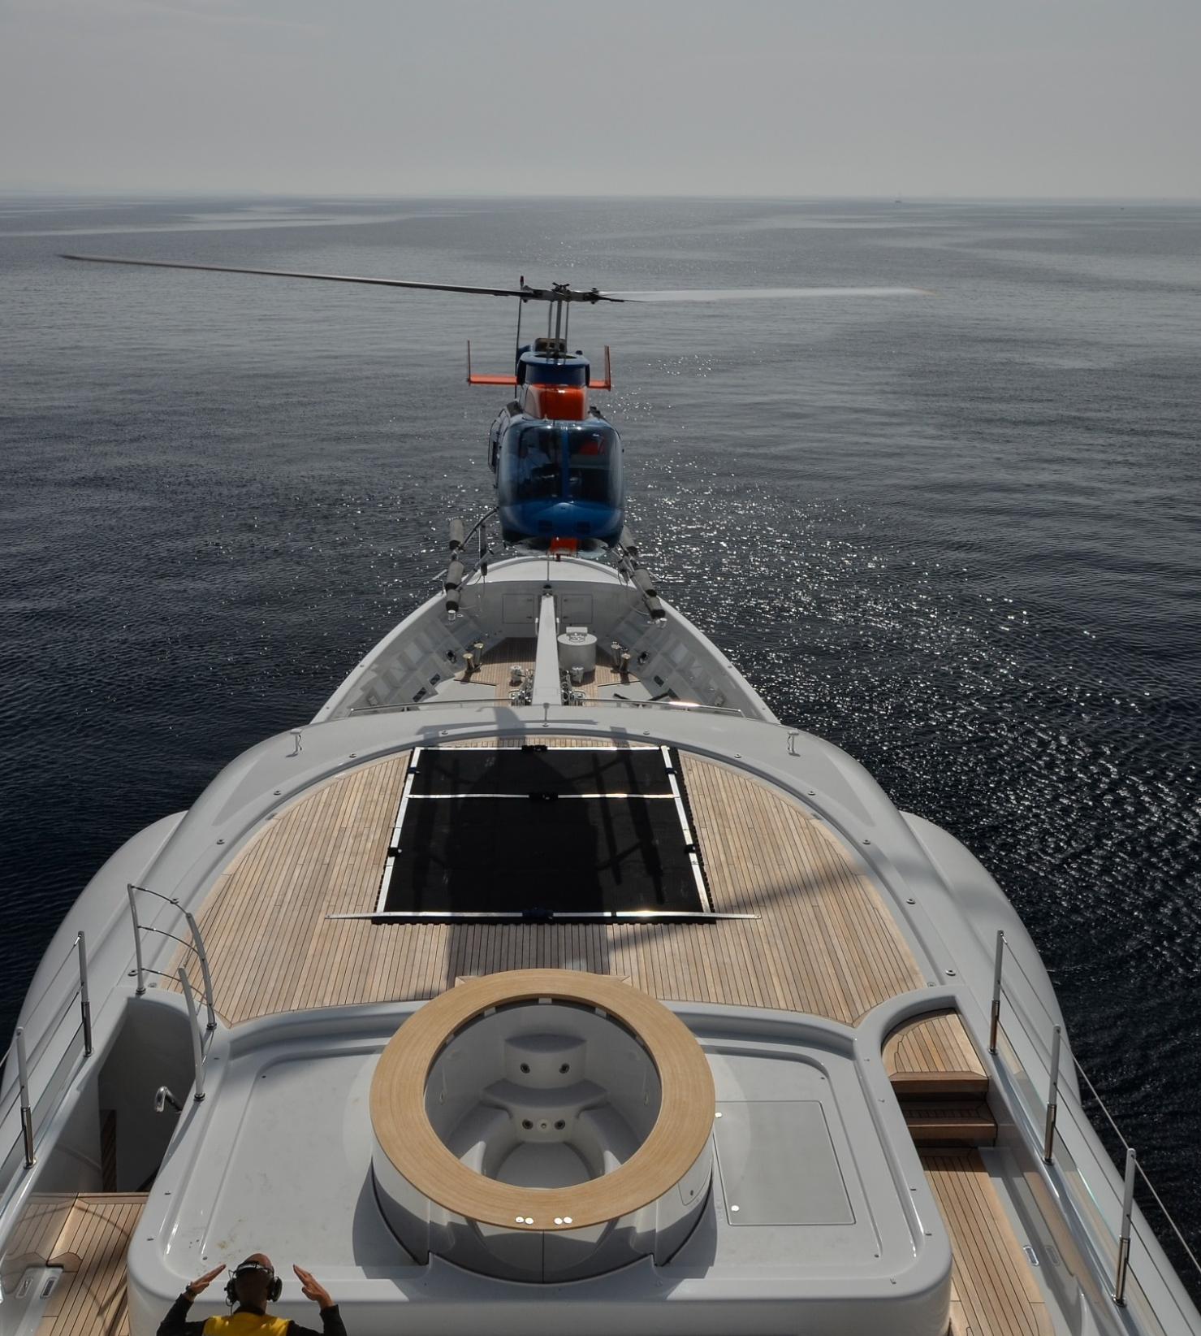
SUPERYACHT AVIATION
Founded in 2007 Helidecks was formed to provide tailor-made aviation services to the Superyacht industry. Well established as the leading Superyacht aviation company Helidecks were the first company to deliver MCA accredited training. Helidecks is the name trusted by the world’s most prestigious designers, builders and yachts.
MCA accredited helideck team training
Helideck design
Safety management
Helicopter integration
Helicopter procurement
Embarked helicopter operations
Helideck audits and operations manuals

Slide 6
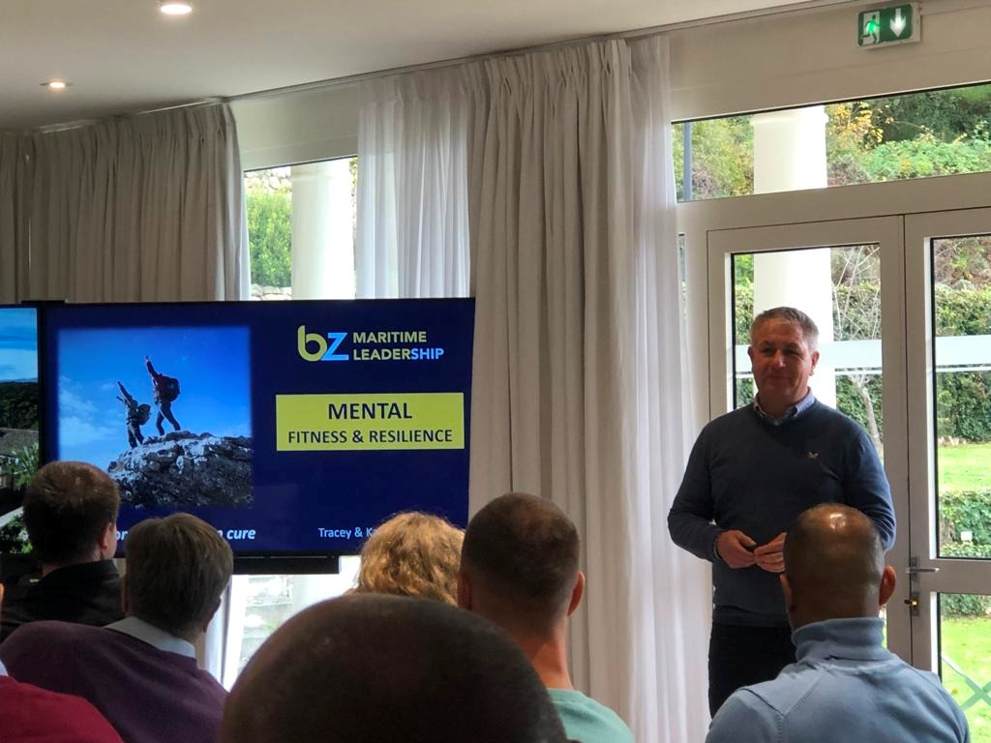

We are specialists at enhancing leadership capability on superyachts, creating high-performing and mentally fit crew and improving the safety culture onboard.
Our team of experts, who are highly experienced maritime leaders and professionally qualified Trainers, can deliver onboard, in the classroom or virtually.
We enable you to deliver the ultimate owner/guest experience.
Leadership development for junior and experienced leaders, including Captains. We also coach individuals and facilitate onboard leadership teams to enhance their effectiveness.
Training for crew to create a performance mindset and whose teamwork excels in the daily ‘365’ work environment or dynamic and pressurised situations.
Proactive training that empowers crew to cultivate great Mental Fitness and Resilience. Proven to be successful at improving onboard mental well-being and underpins crew performance.
Scientifically verified psychometrics that upgrade selection and recruiting processes, greatly reducing the risk of poor hiring decisions as a result of factors such as unconscious bias.
Preparing crew to plan and design, professionally deliver and assess the effectiveness of onboard training and exercises. Raises standards and safeguards the quality of safety critical training.

Slide 7
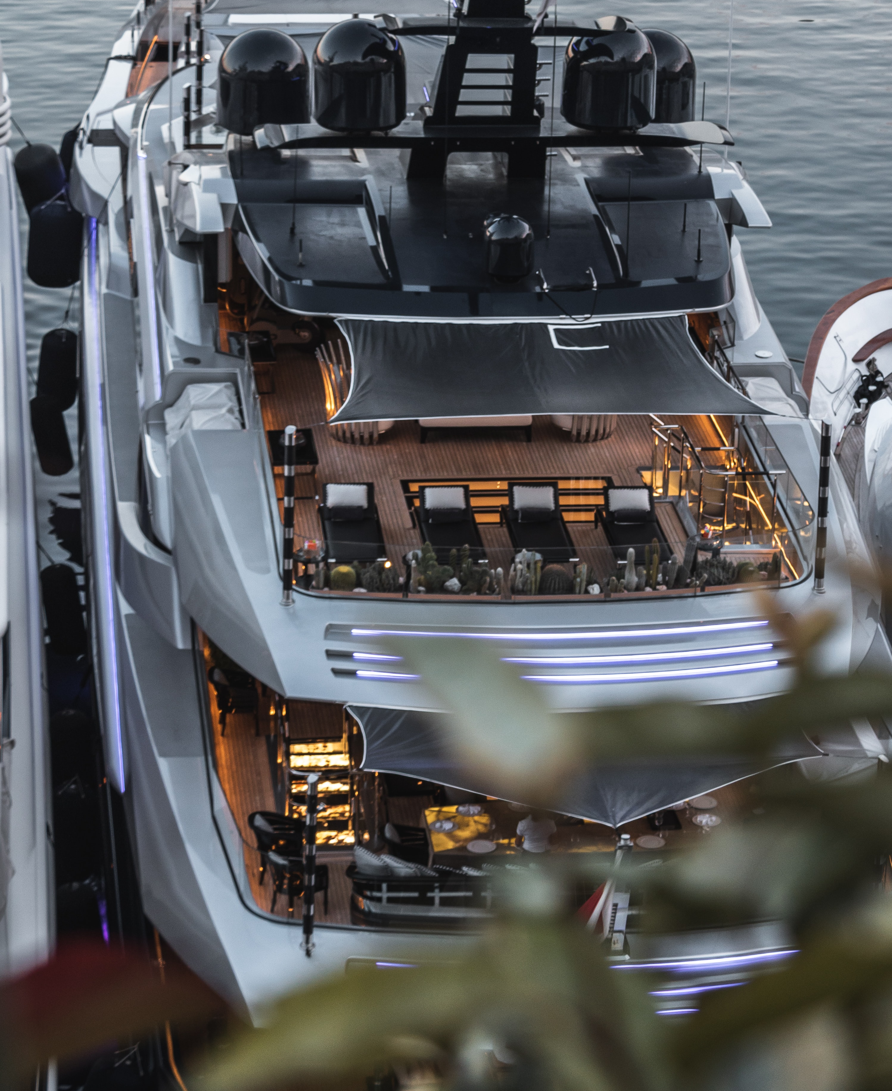
ROMEO FOXTROT
Intelligence led security training
Established to fulfil the requirement for formalised training on privacy and discretion in the superyacht industry, RF empowers the people that make up a crew so they cannot be used against their employer, unwittingly or otherwise.
On board training available:
Human vulnerability awareness
Counter-elicitation
Insider threat detection and management
Surveillance awareness and detection
“An NDA without discretion training is like car insurance without driving lessons”

Slide 8

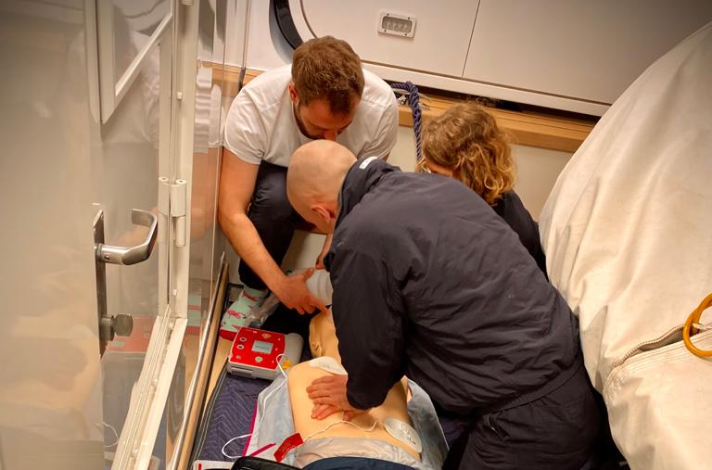
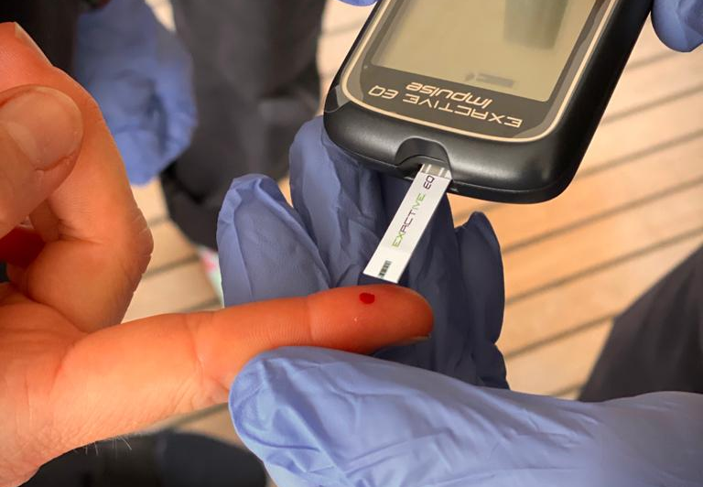
Optimal performance in high-stakes situations requires crew to commit to their training and correct errors while they are in low-stakes learning situations. To achieve this, we base the training around experiential learning with limited but necessary theoretical work to underpin and develop practical skills and understanding.
Tempo and skill requirements are increased as competence develops. We get it wrong in training, so we get it right come the day.
MEDICAL TRAINING
We provide training equipment that matches your own kit on board to give you the ultimate immersive learning experience and leave you feeling confident with accessing and using your own equipment in the event of a real emergency.
Various scenario based training.
Training programmes which can be written specific for each vessel and crew / guest set-up.
Professional guidance and advice in the use of equipment as well as refreshers on medical standards

Slide 9
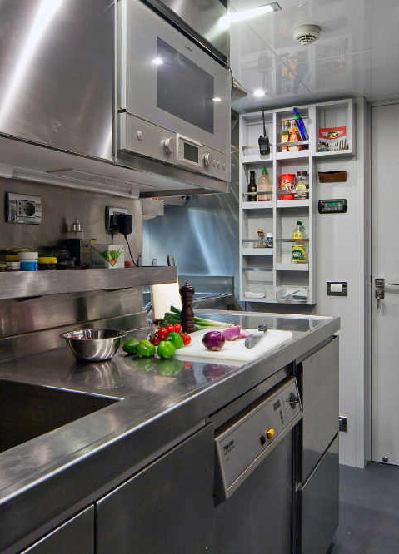
OceanWave Monaco is an Industry leader in bespoke yacht crew training courses. Designed with crew in mind, our maritime training academy is open seven days a week with dedicated yacht training centres in both Monaco and Antibes.
All our trainers have worked in yachting, meaning we offer an exceptional and comprehensive understanding of what yachting is and what it is like to work on board a luxury yacht. Providing training, both onboard and onshore, our unique superyacht training and services can be adapted to fit in with any yacht’s schedule.
Ship’s Cook Assessment, leading to the CISR Ship’s Cook Certificate
Food Safety – level 2, 3 and 4 courses accredited by HABC and compliant to Flag State regulations
Creation of bespoke standard operating procedures and manuals, including HACCP, MARPOL, COSHH, COSWP, MSDS
New build galley design and set-up consultancy

Slide 10
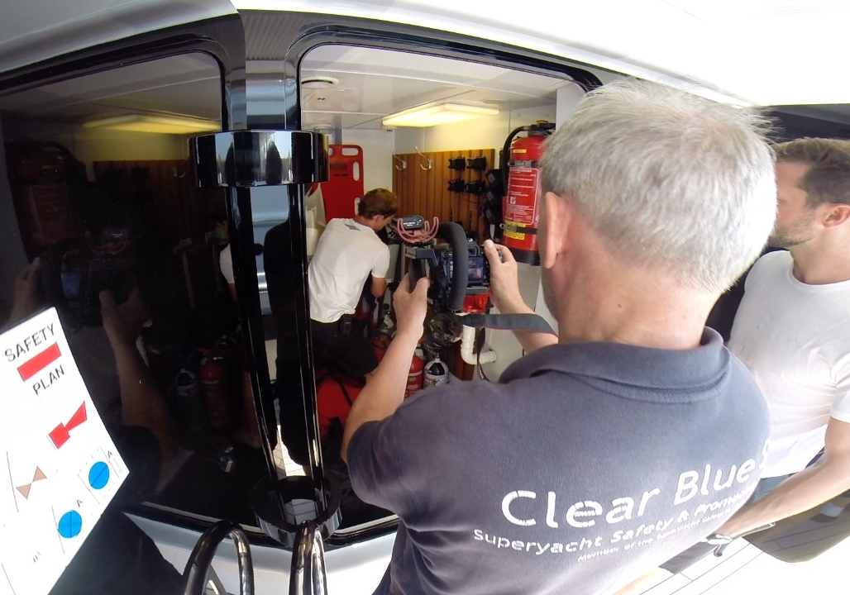

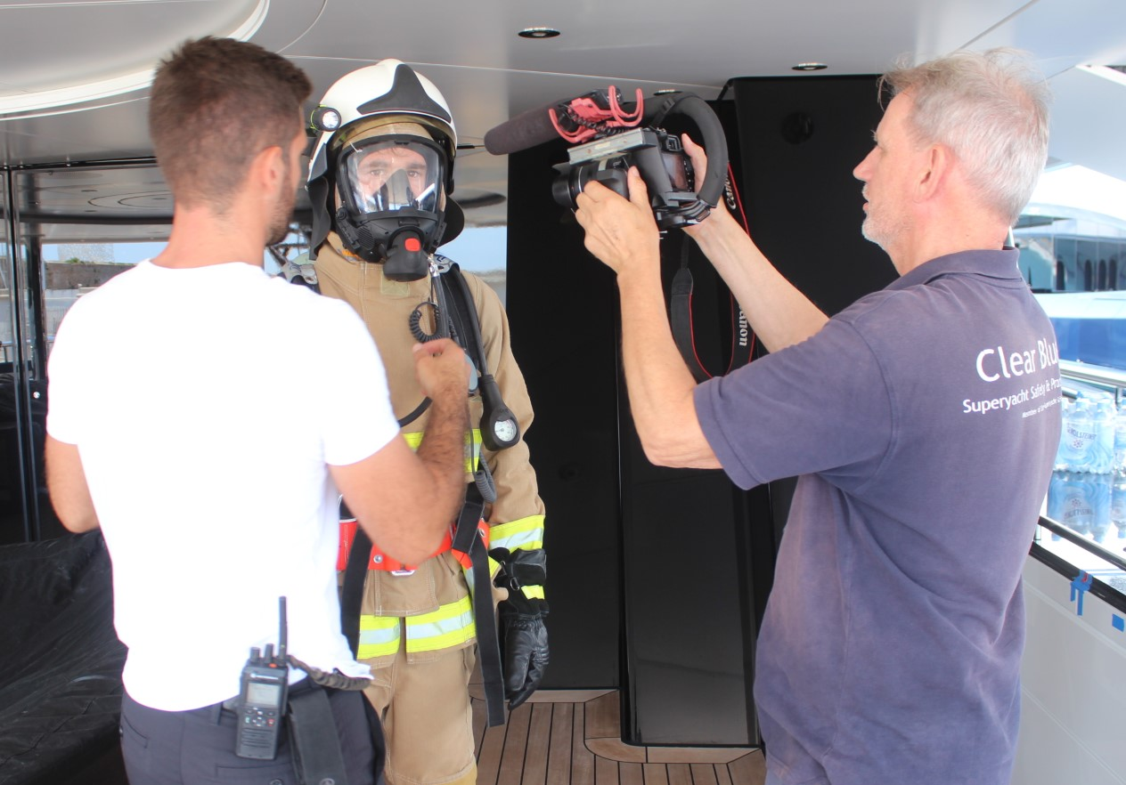
Bringing everything together in a variety of secure video App productions, CBS work with all the training providers and crew to generate bespoke video and image based procedures for the benefit of all those on board. Having worked within the Superyacht industry for over 20 years the film team are experienced enough to know the intricacies of this unique environment and can work around the complexities of builds and refits to generate encapsulating and engaging productions.
Guest safety videos – averaging 4 – 5 minutes these meet the ISM requirements of briefing guests at embarkation to highlight the actions to be taken in an emergency
Crew safety videos - generated during the on board training of the crew, the production is built around the vessel requirements. VTrain App can help train new crew or for refreshers with on board equipment
VSOPS – This package is generated during the provisional training period but with an emphasis on the specific SOPS for the yacht as briefed by the command team and provides a valuable resource for standard operating procedures in a bespoke and secure video VSOPS App

Slide 11
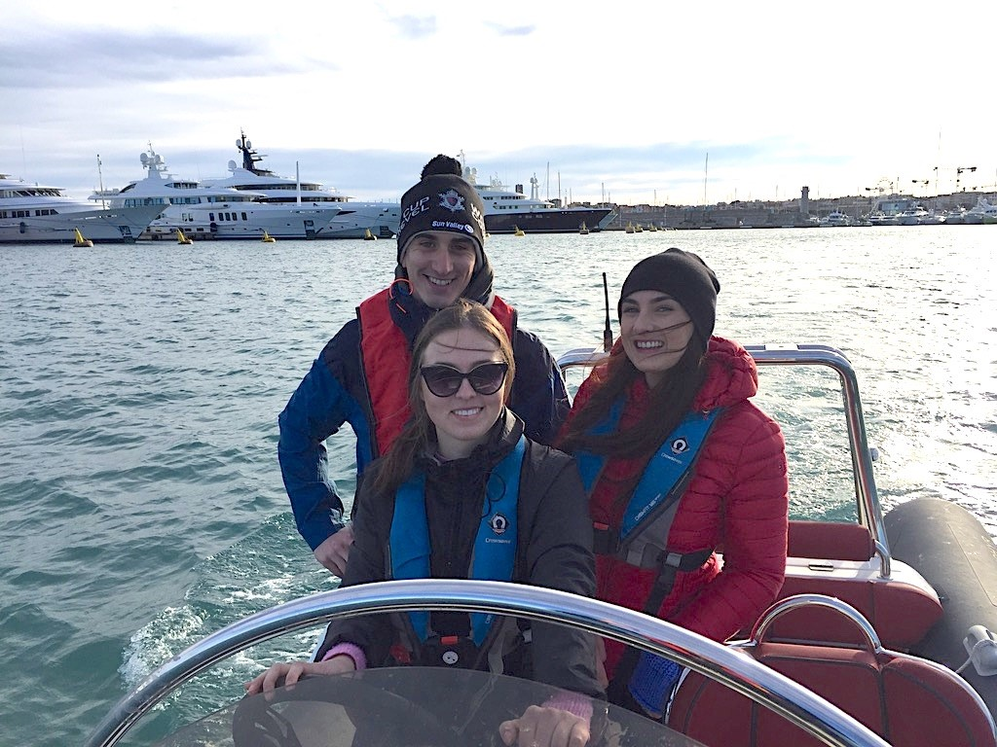
This RYA Level 2 Powerboat Handling course provides the skills and background knowledge needed by the competent powerboat driver.
It teaches boat handling and seamanship in powerboats and focuses on low-speed close quarters handling, man overboard recovery, an introduction to driving at planing speed and collision regulations.
While not an obligatory requirement, it has now become industry standard for yacht crew to obtain the powerboat Level 2 and it is recognised by most European administrations for the operation of small craft under 10m.
The certificate issued will be endorsed to show the type of boat in which the training took place.
This qualification also allows successful candidates to apply for the International Certificate of Competence (ICC).
Courses take place over 2 days
Instructor / Student ratio 1:3
No prior knowledge or experience necessary
Candidates must have a working knowledge of written and spoken English
Access to a powerboat will be provided by the course provider
Examinations are included in the cost
Courses are based around Monaco and Antibes

Slide 12
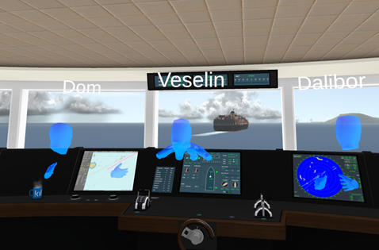
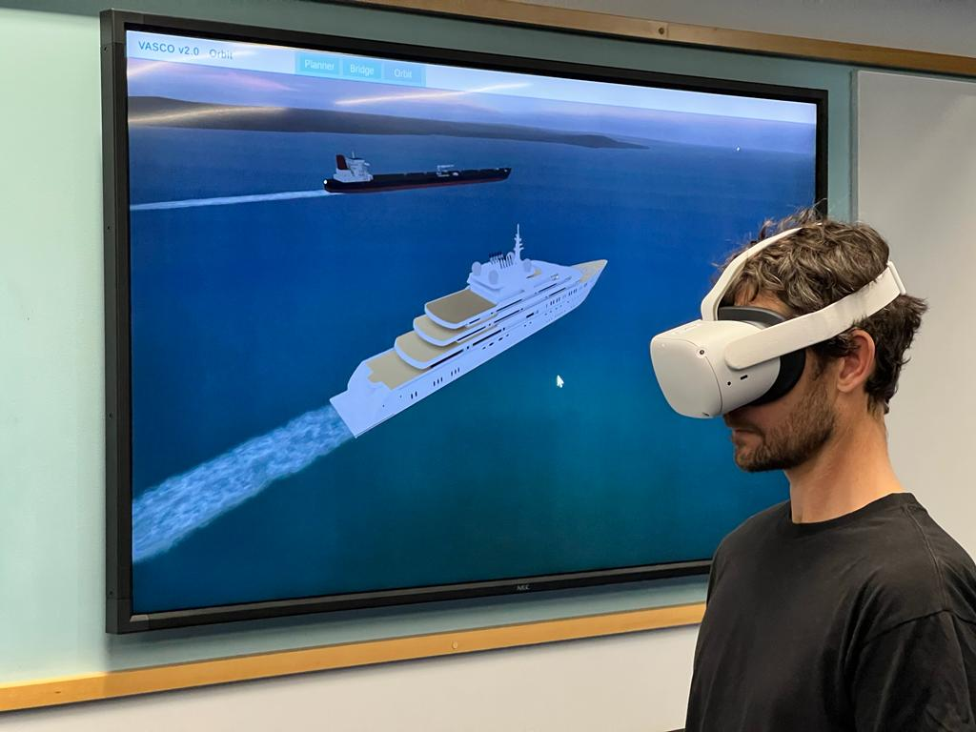
Kilo Solutions delivers portable VR bridge simulators for the superyacht sector, helping owners, captains and crew improve bridge competence, strengthen operational readiness and reduce risk at sea.
Combining maritime expertise with immersive digital technology, Kilo, aside from the technology, also provides practical VR bridge training that helps crews build skill, maintain standards and strengthen onboard safety culture through realistic, measurable immersive scenarios.
Portable VR bridge simulators for the superyacht sector
Immersive bridge training for real-world operational scenarios
Cloud-connected and self-contained VR simulator solutions
Accessible onboard, shoreside, or remotely via Wi-Fi or local network
Practical training for BRM, ColRegs, situational awareness and decision-making
Helps reduce skill fade and maintain bridge team competence
Strengthens onboard safety culture and operational readiness
Scalable for individual crew, full bridge teams and fleet operations
Built by maritime specialists for modern yacht operations

Slide 13
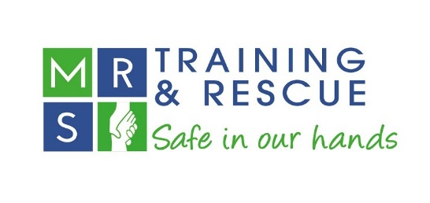
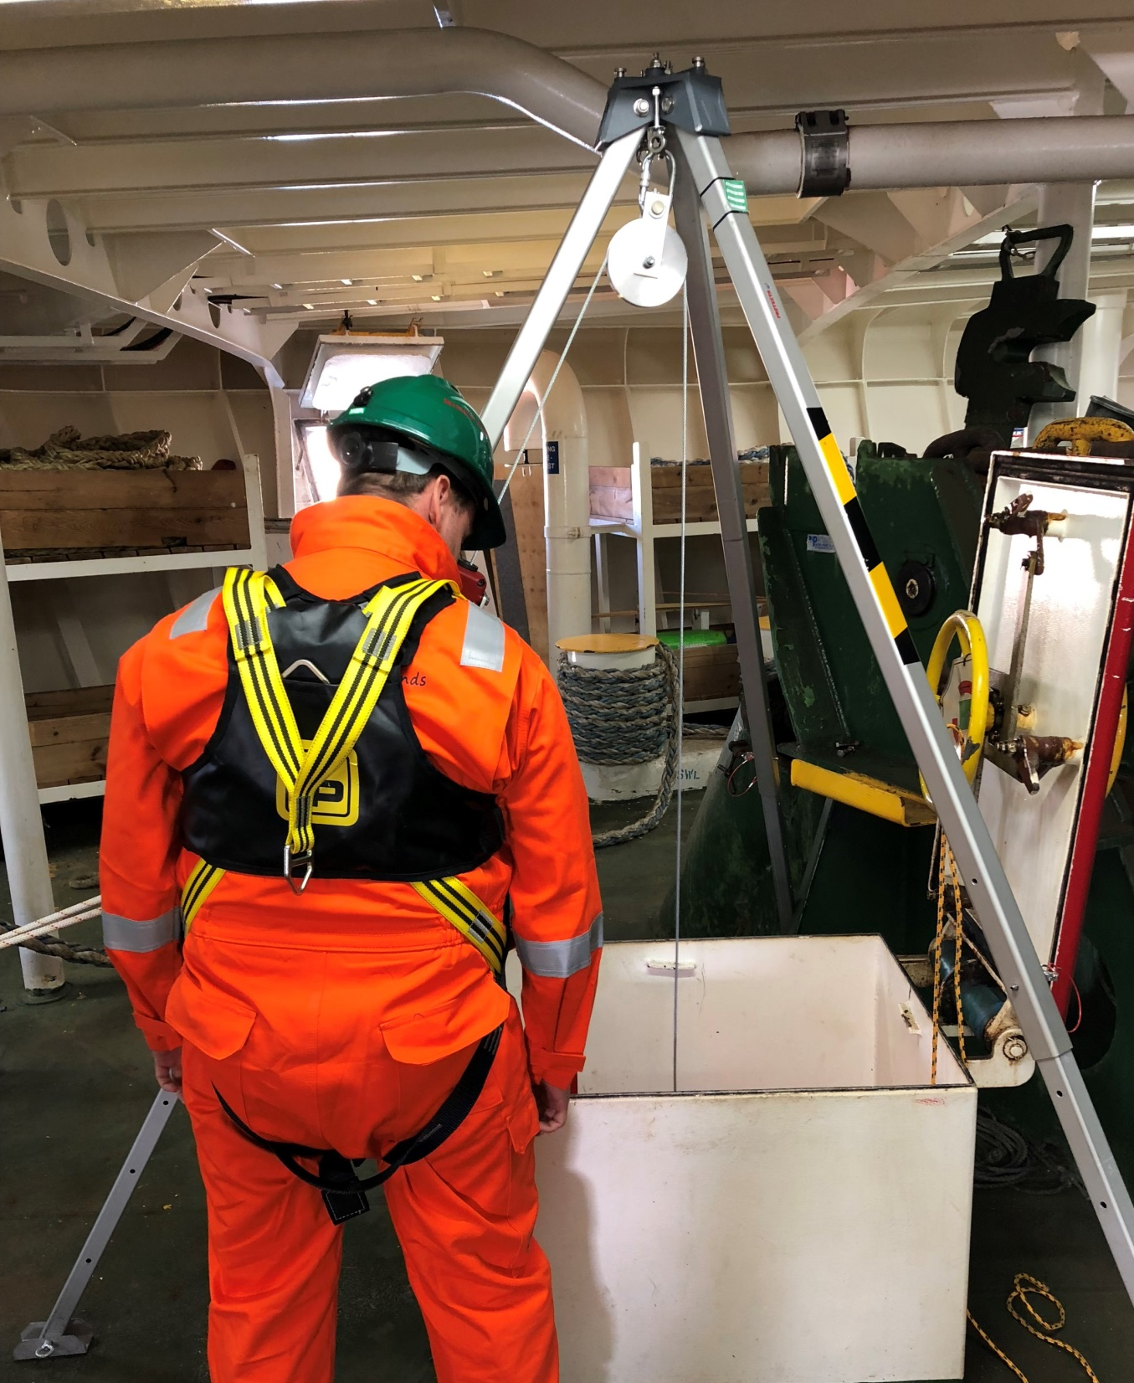
Established over 100 years ago, this company has adapted their skills, experience and knowledge from the potentially high-risk environments of their heritage to specifically work within the maritime industry with a growing client base in the Superyacht market.
Our qualified expert trainers will actively work with crew from the early stages of build to assist in design and development of safe working procedures both aloft and in confined spaces as well as provide advice and guidance in the equipment procurement.
Consultancy services for on board procedures and equipment procurement advice
City and Guilds qualifications for crew in confined space training with MNTB accreditation
Working at Height training and rescue courses approved by the ECITB and PASMA
Health and safety consultancy services across the world

Slide 14




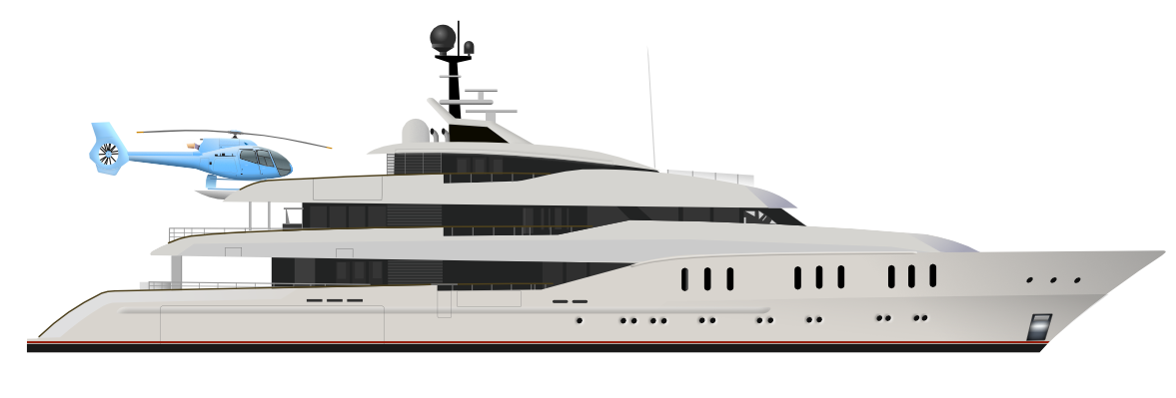


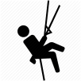
Simplifying costs through a single invoice
Bringing the leading industry training providers direct to you
Enhancing your procedures, in your environment with your equipment
Providing a single point of contact coordinator to work with the HOD’s
Reducing costs and time spend sending individual crew to training locations
Working around your schedule to provide effective, professional and highest quality training
Providing the perfect annual crew refreshers on schedule and budget
Simply improving crew training across the Superyacht industry.

Slide 15
On board crew training at your location.
+ 44(0)1243 511 084
info@superyachttraining.org
www.superyachttraining.org

